Slide 1
U.S. Foreign Policy in the Age of Imperialism
Mr. Accetta
Social Studies 8

Slide 2
Treaty of Paris (1898)
Peace treaty between the United States and Spain that officially ends the Spanish-American War.
Spain forced to give up most of its empire.
Puerto Rico, Guam, and the Philippines are ceded (given) to the United States; Cuba becomes a U.S. protectorate.

Slide 3
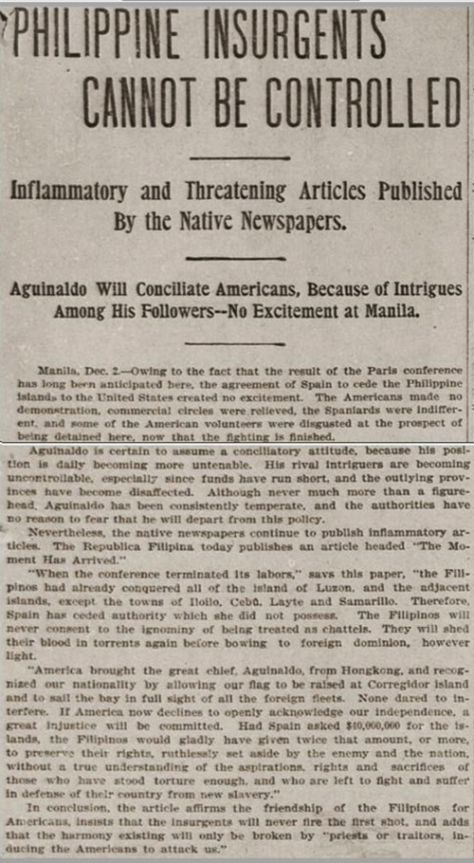
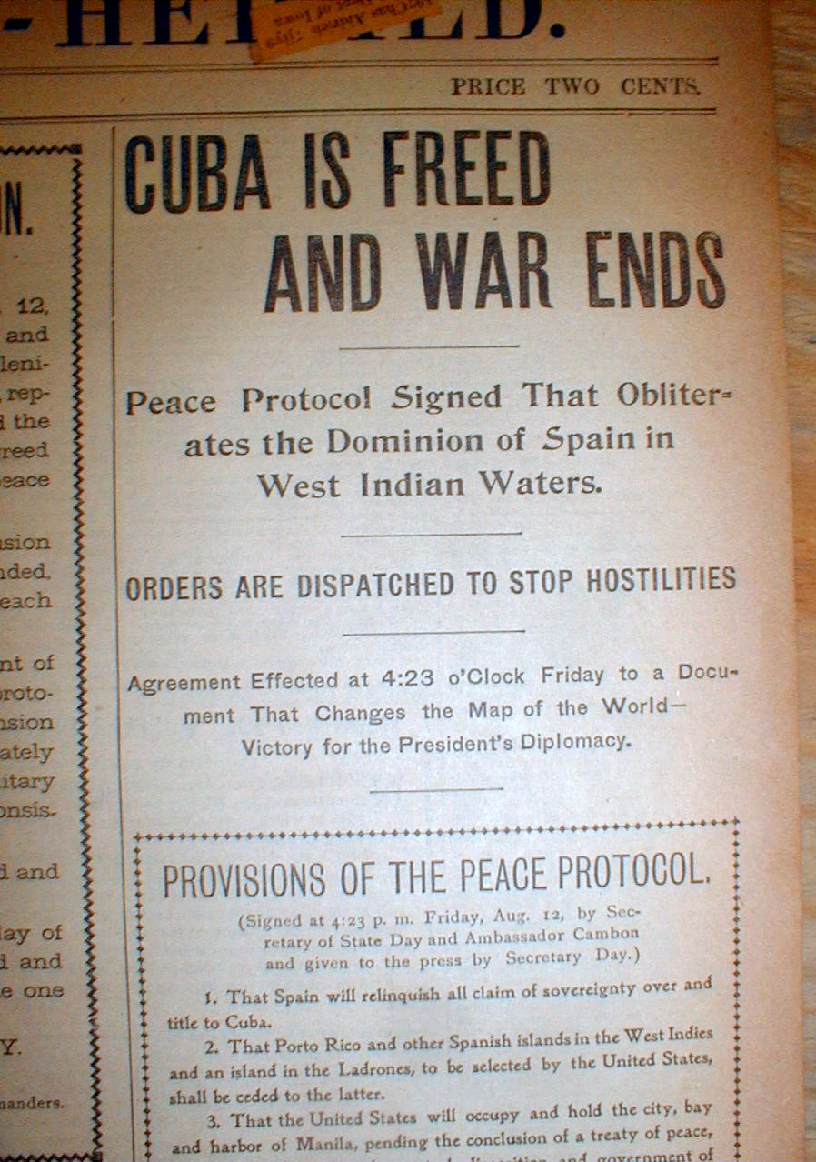

Slide 4
U.S. Foreign Policy Under Theodore Roosevelt
Monroe Doctrine (1823): Policy proposed by President James Monroe that the U.S. will oppose European involvement in Latin America.
Roosevelt Corollary (1904): Roosevelt’s addition to the Monroe Doctrine, saying that the U.S. will directly intervene in conflicts between European and Latin American countries to enforce peace.

Slide 5
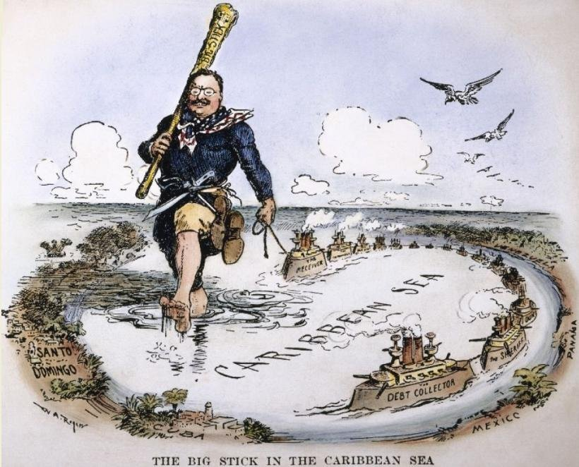
“Big Stick” Diplomacy
Comes from a quote by Theodore Roosevelt: “Speak softly and carry a big stick; you will go far.”
What do you think Roosevelt means by this?

Slide 6
“Big Stick” Diplomacy
Attempting to avoid conflict through peaceful negotiations, but being able to take action if necessary.
Example: Venezuelan Affair of 1902- Britain and Germany accused Venezuela of acting violently towards them and not paying debts.
Britain/Germany establish a naval blockade; U.S. opposes it by stationing naval forces in Cuba.

Slide 7
Dollar Diplomacy
America’s use of economic power to resolve conflicts with foreign nations, designed to benefit both sides.
Used by William Howard Taft.
Taft hoped that by helping Latin American nations achieve financial stability, they could then trade with the U.S.
Examples: paying off debts owed by Honduras and Haiti

Slide 8
Moral Diplomacy
Form of diplomacy in which the U.S. only supports countries who share their beliefs about government.
Proposed by Woodrow Wilson.
Wilson hoped to support other democratic nations in Latin America while harming non-democratic nations, who were viewed as potential threats.
Stems from the idea that the U.S. had a responsibility to spread the values of freedom and democracy around the world.

Slide 9
Let’s Play…Name That Diplomacy!

Slide 11
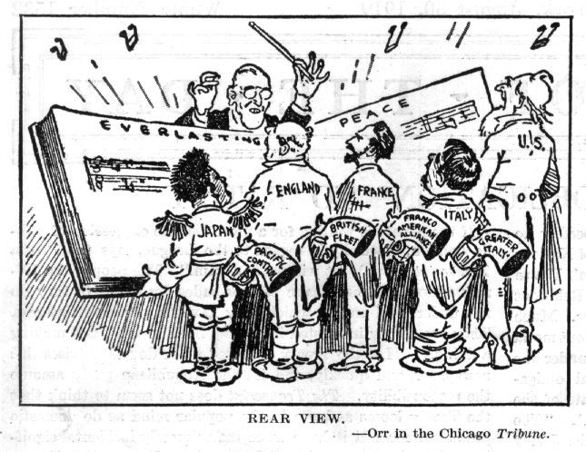

Slide 12
Panama Canal

Slide 13
Panama Canal
“The World’s Most Important Shortcut”
Roosevelt believed that building a canal connecting the Atlantic and Pacific Oceans was key to making America a powerful player on the world stage.
Despite many difficulties, including tropical disease, engineering difficulties, and opposition

