Slide 1
Muckrakers
Mr. Accetta
Social Studies 8

Slide 2
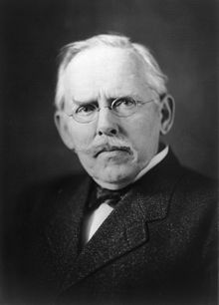
Jacob Riis (1849-1914)
Issue: Tenements
Title of Work: How the Other Half Lives (1890)
Reform He Helped Pass: Various inspection laws that improved conditions in tenements

Slide 3
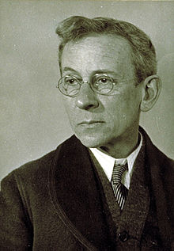
Lewis Hine (1874-1940)
Issue: Child Labor
Title of Work: Hundreds of photos published in newspapers and magazines
Reform He Helped Pass: Child labor laws

Slide 4
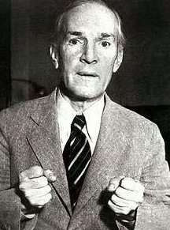
Upton Sinclair (1878-1968)
Issue: Meatpacking
Title of Work: The Jungle (1905)
Reforms He Helped Pass: Meat Inspection Act (1906), Pure Food and Drug Act (1906)

Slide 5
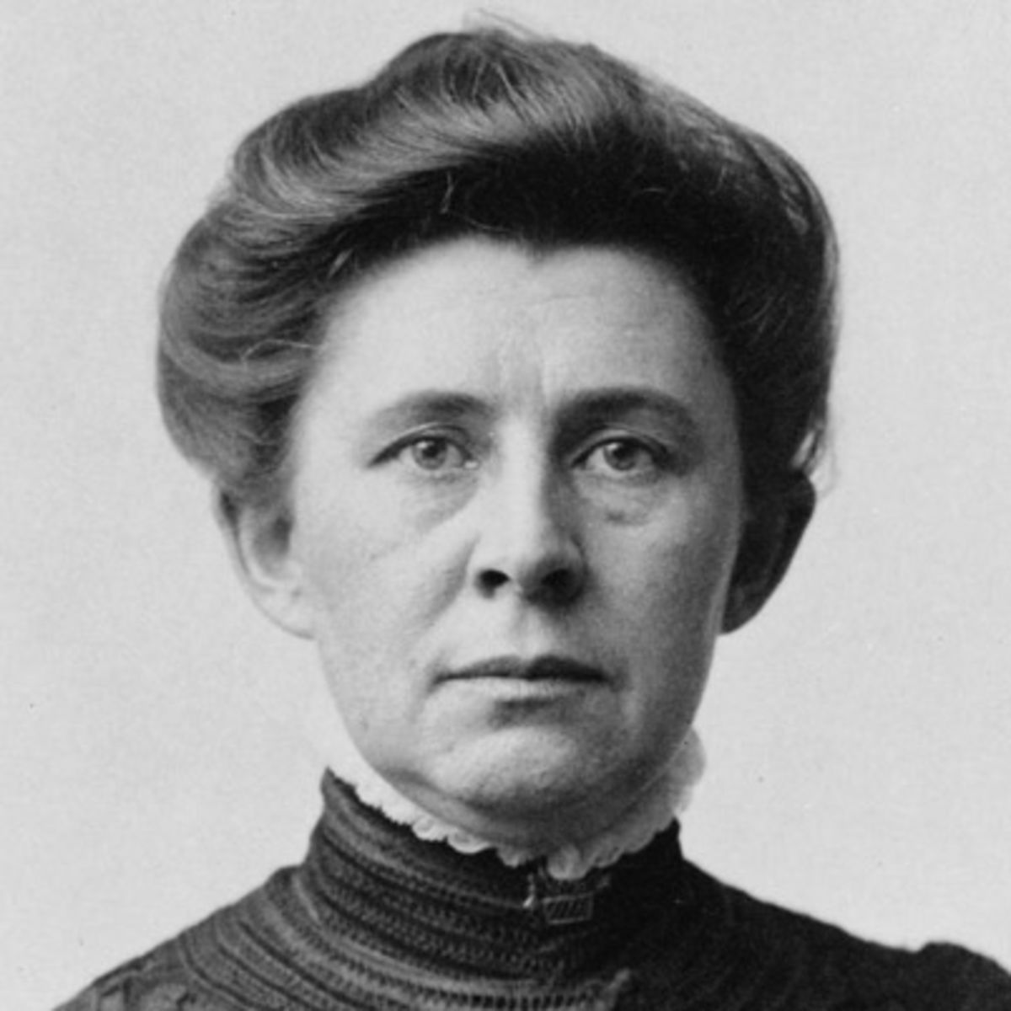
Ida Tarbell (1857-1944)
Issue: Oil Trust (Monopoly)
Title of Work: The History of Standard Oil Company (1902)
Reform: Sherman Antitrust Act (1890)- Regulated big businesses and trusts

Slide 6
Oil Trusts
Monopoly: when a single company controls an entire industry.
Trust: a type of monopoly in which stockholders control prices.
From 1890 to 1911, Nelson D. Rockefeller’s Standard Oil Company had a monopoly on oil in the United States.
With no competition, Standard Oil was able to control the oil industry and prices.

Slide 7
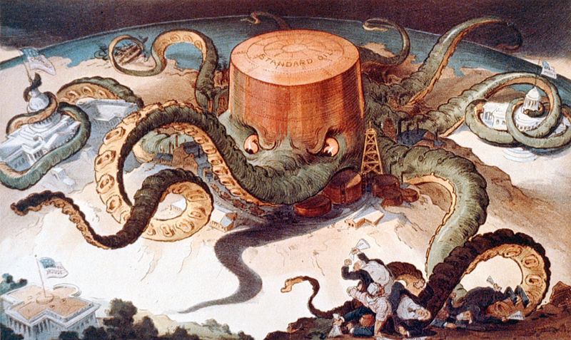
“Next!” (1904)

Slide 8
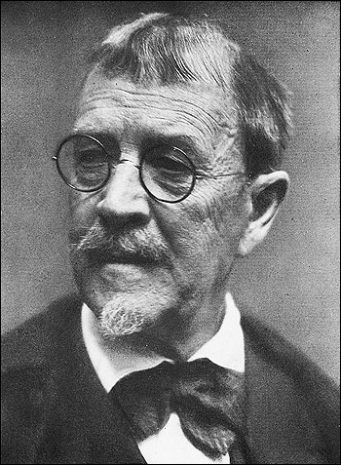
Lincoln Steffens (1866-1936)
Issue: Political Corruption
Title of Work: The Shame of the Cities (1904)
Reform He Helped Pass: 17th Amendment (1913)- Direct election of senators

Slide 9
Political Corruption
During the late 1800s-early 1900s, elections in the United States were controlled by political machines.
These were powerful organizations that counted ballots and often changed the number of votes to ensure victory for certain candidates.
The most notorious political machine was Tammany Hall in New York, led by William “Boss” Tweed.

Slide 10
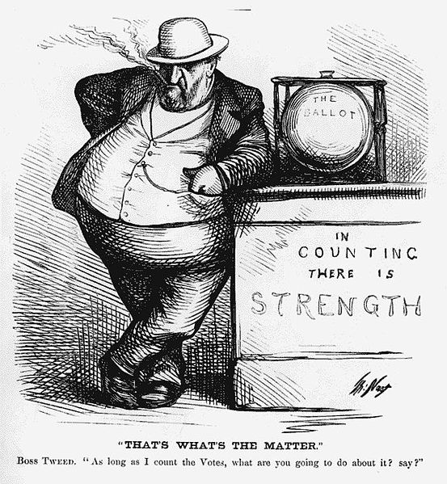
“That’s What’s The Matter” (1871)

