Slide 1
D-DAY
Mr. Accetta
Social studies 8

Slide 2
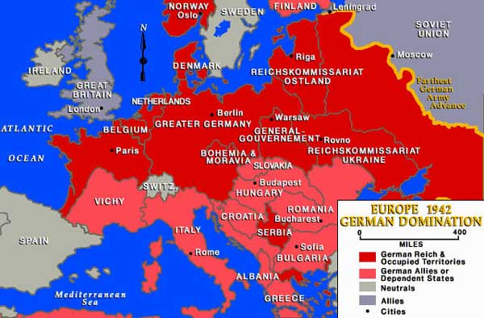
BACKGROUND:
By 1942 the Nazis and their allies had taken over nearly all of Europe.

Slide 3
D-Day Invasion
The Allied Powers knew they had only one chance at a counterattack.
June 6, 1944: Allied forces landed on Normandy Beach in western France.
Won a major victory over the Nazis, which allowed them to push further into Europe.
Known as D-Day (“Designated Day”)

Slide 4
View from one of the Allied landing vessels

Slide 5
Soldiers took cover in trenches dug in the sand

Slide 6
Imagine if you were a Nazi and saw this coming for you…

