Slide 1
Causes of World War I
Mr. Accetta
Social Studies 8

Slide 2
Do Now:
Think back to our lesson from last week. Based on the visual sources we examined, what conclusions can we draw about World War I?

Slide 3
Remember: M.A.I.N.
M: Militarism
A: Alliances
I: Imperialism
N: Nationalism

Slide 4
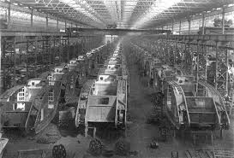
Militarism
The belief or desire of a government or people that their country should maintain a strong military.
During the early 1900s, many countries in Europe were building up their militaries, leading to tension between them.

Slide 5
Alliances
Unions or association between nations designed to benefit both sides.
Alliances at the start of the war (1914):
Triple Alliance | Triple Entente
Germany | Great Britain
Austria-Hungary | France
Italy | Russia
Tensions continued to build as more nations joined each side and the system of alliances became more complex.

Slide 6
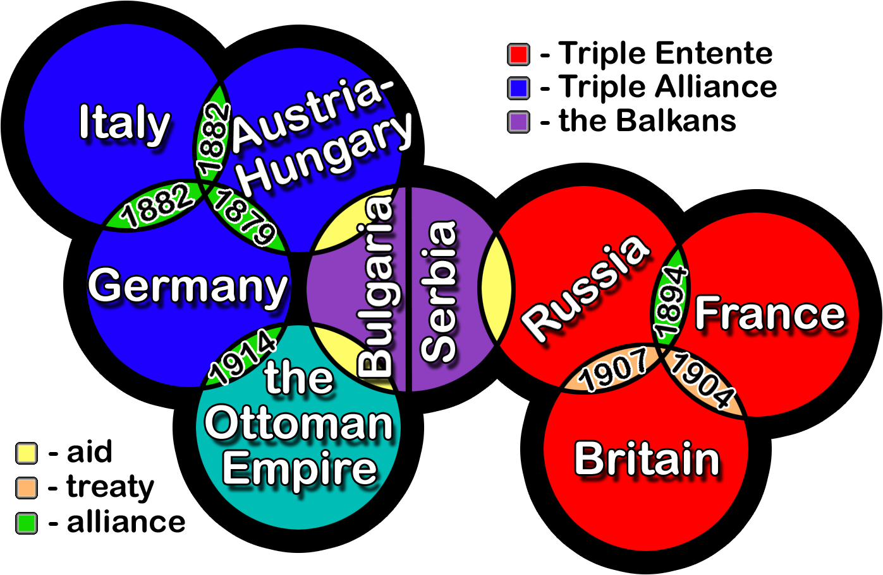
Alliances in WWI

Slide 7
Imperialism
The policy of extending a nation’s influence through military or diplomatic action.
During the late 1800s-early 1900s, many nations were competing with one another to build the biggest empire and establish themselves as global powers.

Slide 8
World Empires in 1914

Slide 9
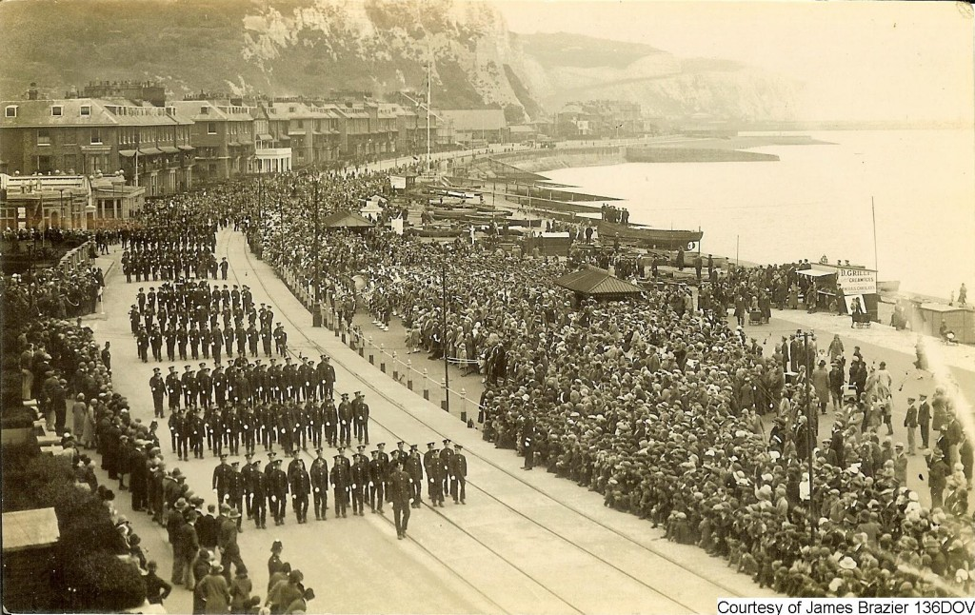
Nationalism
Strong pride in one’s country; patriotism.
Underlying all of these other causes of the war was each nation’s desire to prove that they were the best and strongest.

Slide 10
Assassination of Archduke Franz Ferdinand (July 28, 1914)
Franz Ferdinand, Archduke of Austria, was assassinated by a Serbian nationalist.
Austria declared war on Serbia; Serbia’s supporters (Britain, France, Russia) joined on their side.
World War I officially begins.

