Slide 1
World War II: This Time, It’s Personal
Mr. Accetta
Social Studies 8

Slide 2
Do Now:
How can different views of power and morality (right vs. wrong) lead to global conflict?

Slide 3
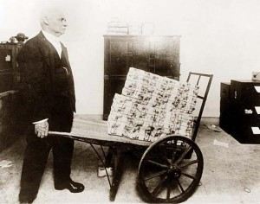
After WWI:
Germany suffers from inflation as a result of worldwide depression and having to pay reparations to Britain and France.
Inflation: Rise in prices in relation to the amount of money available.
A German man with a wheelbarrow of marks (German currency). Marks were so worthless after WWI that a wheelbarrow full was often needed to buy simple goods like milk or bread.

Slide 4
Rise of Dictators
Humiliated, Germany and Italy turn to fascism.
Fascism: a form of government that is a type of single party dictatorship.

Slide 5
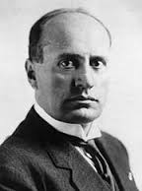
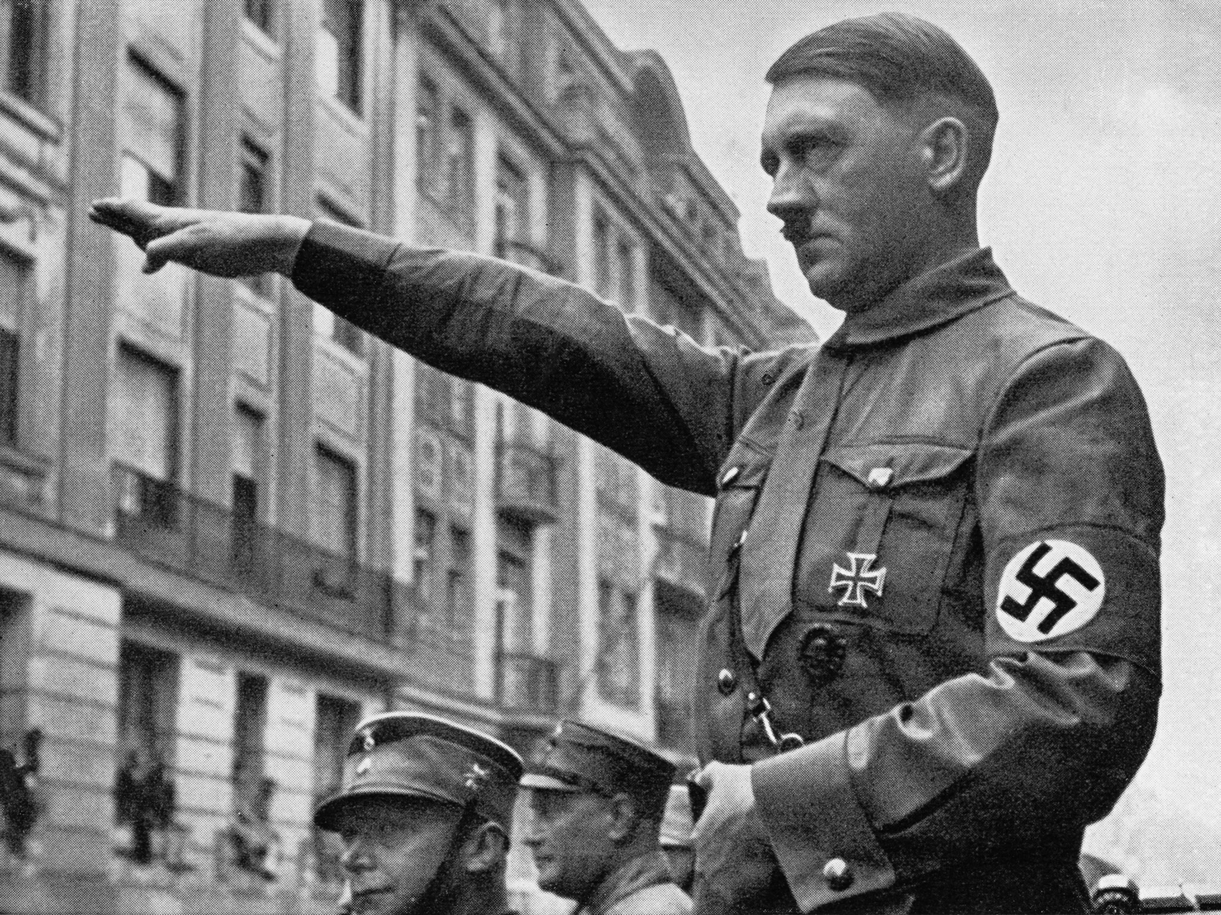
Rise of Dictators
Adolf Hitler (1889-1945): Leader of Nazi Party in Germany
Benito Mussolini (1883-1945): Leader of National Fascist Party in Italy
Adolf Hitler. Note the Swastika (Nazi Party emblem) on his armband.
Benito Mussolini

Slide 6
Hitler’s Rise to Power
Hitler gained popularity by attacking the Treaty of Versailles and promoting anti-Semitism (hatred of Jews) and strong German nationalism.
Began building up military and annexing territory.
Officials in Britain and France allowed this, hoping that if Hitler was satisfied, they could avoid conflict.
This policy was known as appeasement.

Slide 7
How does this political cartoon demonstrate appeasement?
(Bonus points if you can guess the cartoonist: You should ALL know who he is!)

Slide 8
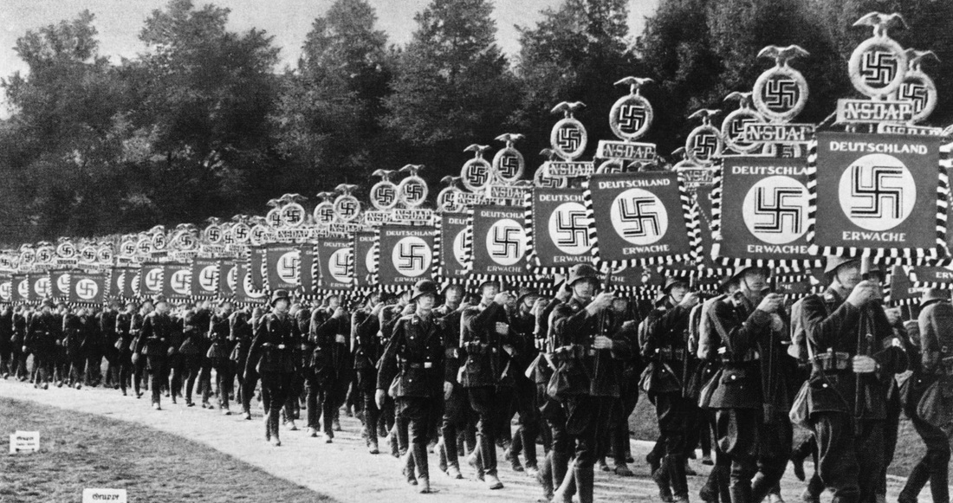
WWII Begins
September 1, 1939: Nazis invade Poland, leading Britain and France to declare war on Germany. World War II officially begins.

