Slide 1
Do Now:
Critical Thinking: Based on what we have learned about the causes of World War I, predict how the United States might have gotten involved in the war.

Slide 2
The U.S. Enters the War
Mr. Accetta
Social Studies 8

Slide 3
Review:
At the start of the war, the U.S. was neutral.
Neutral = not on either side
This was because the U.S. had a policy of isolationism.
Isolationism = refusing to get involved with other countries’ affairs.

Slide 4
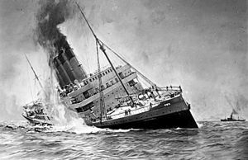
The Sinking of the Lusitania
May 7, 1917: British ocean liner Lusitania is sunk by a German u-boat (submarine).
Over 1000 people were killed, including 128 Americans.

Slide 5
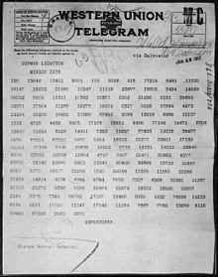
Zimmermann Telegram
Secret telegram intercepted by Britain in January 1917.
Sent from Germany to Mexico, proposing an alliance between the two countries.

Slide 6
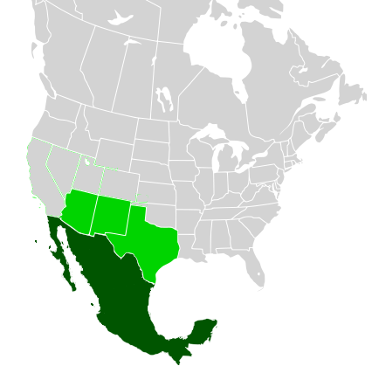
Zimmermann Telegram
Germany promised to help Mexico reclaim territory in the Southwest United States in exchange for helping Germany win WWI.

Slide 7
America Officially Enters the War
As a result of these events, the U.S. declares war on Germany on April 6, 1917.
Joins the Allied Powers (Britain, France, Russia, Serbia, etc.)
American soldiers (Known as “doughboys”) led by General John Pershing, had a significant role in the Allies’ victory in the war.

Slide 8
Do Now:
Identify one reason the United States entered World War I. Be sure to explain how this led to the United States entering the war.

Slide 9
Review Questions:
1) Describe the U.S.’s position when World War I first started.
2) What happened to the Lusitania? How did this draw the U.S. closer to joining the war?
3) What was the Zimmermann Telegram? How did this draw the U.S. closer to joining the war?
4) What impact did the United States have on the outcome of the war?

Slide 10
Please respond to the following question in a well developed paragraph of at least 5-6 sentences:
Based on our class discussion, do you believe that the United States made the right decision to enter World War I? In other words, was their decision justified? Explain using specific evidence from our class notes/discussion.

