Slide 1
The Life and Times of Theodore Roosevelt
(Mr. Accetta’s Favorite President)
Social Studies 8

Slide 2
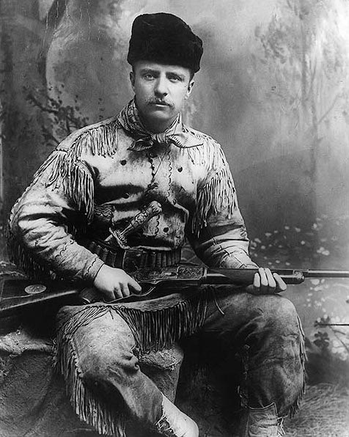
Early Life
Born October 27, 1958 in NYC.
As a child he was sickly, but very interested in nature
Attended Harvard University
Worked as a rancher in South Dakota in 1884-1886

Slide 3
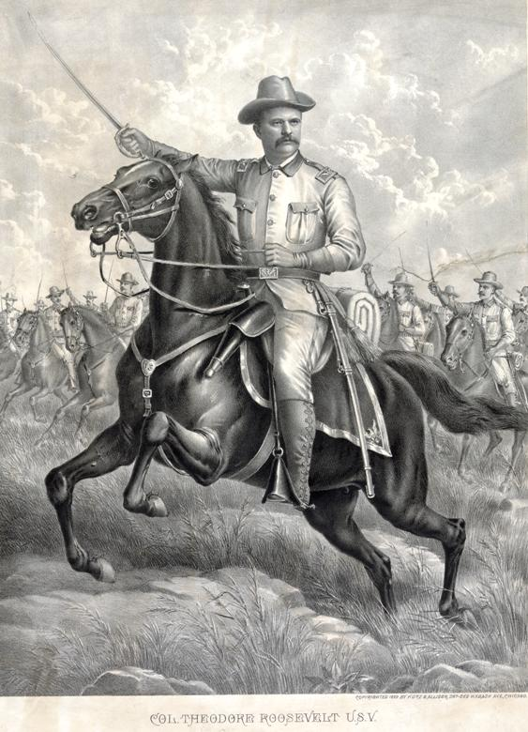
Early Life Continued
Led group of soldiers known as the “Rough Riders” during the Spanish-American War in 1898.
Elected Governor of New York in 1898.
March 4, 1901: Elected Vice President of the United States under President William McKinley.
September 14, 1901: McKinley is assassinated; Roosevelt becomes the President of the United States

Slide 4
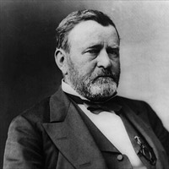
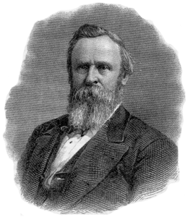
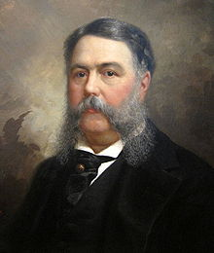
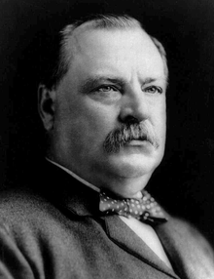
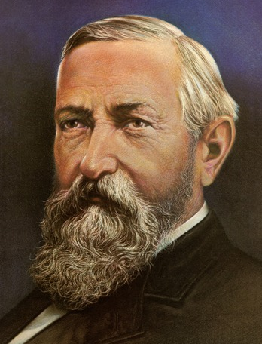
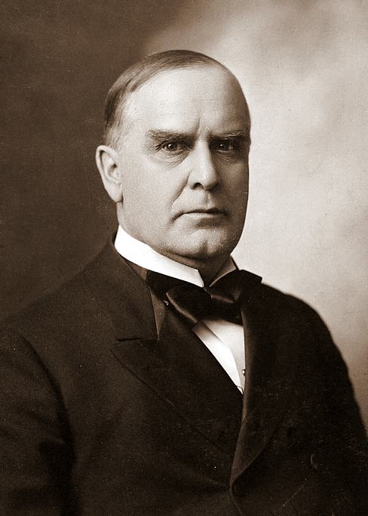
1868-1901: “The Era of Presidential Facial Hair”
From 1868 to 1901, the Presidents of the United States had luscious facial hair but did not do much else; CONGRESS largely controlled the government.
Upon his inauguration, Roosevelt set out to break this trend and re-establish presidential authority.

Slide 5
Roosevelt’s Plan:
The Square Deal
“Three C’s”
Conservation of the Environment
Control Big Business
Consumer Protection

Slide 6
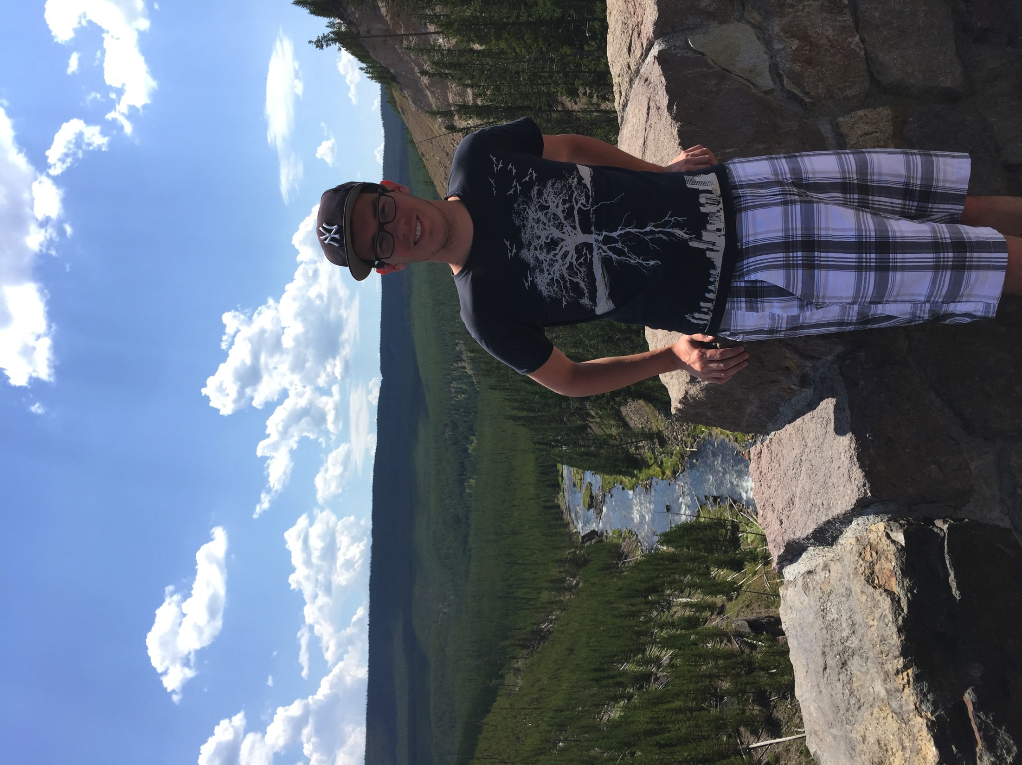
Conservation of the Environment
Believed that America’s wilderness and natural resources needed to be preserved.
Established the National Park Service.

Slide 7
Control Big Business
Nicknamed “trustbuster”
Used the Sherman Anti-Trust Act (1890) to break up and regulate trusts and monopolies.
Coal Strike of 1902: Roosevelt demanded that mine owners give miners higher pay and shorter working hours.
This marked the first time a President took the side of the workers in a labor dispute.

Slide 8
Consumer Protection
Passed laws that protected consumers (customers)
Pure Food and Drug Act/Meat Inspection Act (1906)- required federal inspection of food and drugs and established Food and Drug Administration

