Slide 1
The Meatpacking Industry
Mr. Accetta
Social Studies 8

Slide 2
Background
Of all the industries that emerged during the late 1800s, meat packaging factories were the most dangerous- both for workers AND the public.
Mostly employed immigrant workers; forced them to work long hours for low wages

Slide 3
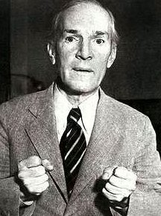
Upton Sinclair (1878-1968)
Muckraker who went undercover in Chicago’s meatpacking plants to find out the shocking and disturbing truth of what was going on there.
Wrote a book about his experiences entitled The Jungle (1905).

