Slide 1
THE AGE OF IMMIGRATION
Mr. Accetta
Social Studies 8

Slide 2
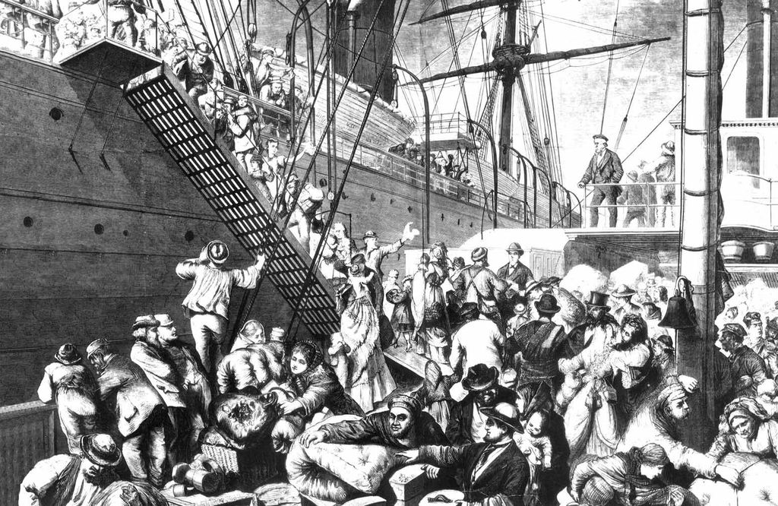
BACKGROUND
From the 1870s to around 1900, a LOT was happening in America.
While industry and cities grew, more than 20 million immigrants arrived in America from all over the world.
These immigrants came to America for a variety of reasons, and helped shape America into the diverse nation it is today.

Slide 3
History of immigration- “old” vs “new”
“OLD” IMMIGRANTS | “NEW” IMMIGRANTS
Arrived before 1880 | Arrived 1880-1910
From Northern/Western Europe (Ireland, Germany, England) | From Southern/Eastern Europe; Asia (Russia, Italy, Greece, Slavic nations, China)
Adapted quickly to American culture | “Held on” to their native cultures
Mostly white Protestants | Catholic, Orthodox, Jewish

Slide 4
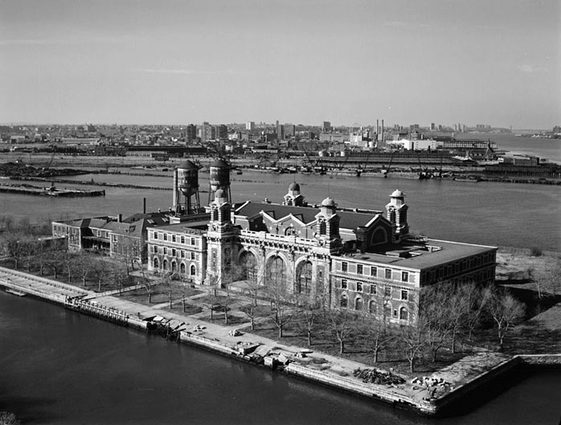
ELLIS ISLAND
Station in New York Harbor through which over 12 million immigrants entered America between 1892 and 1954.

Slide 5
Push factors
Push Factor: Something that forces immigrants to leave their homeland.
What push factors do you think might have caused immigrants to leave their home countries from 1870 to 1914? Discuss with an elbow partner.

Slide 6
Push factors
War/Violence
Famine
Poverty
Persecution
Natural Disasters
Unemployment

Slide 7
Pull Factors
Pull Factor: Something that attracts immigrants to a new country
What pull factors do you think might have caused immigrants to leave their home countries from 1870 to 1914? Discuss with an elbow partner.

Slide 8
Pull factors
Safety
Peace
Stability
Freedom
Employment Opportunities

Slide 9
Immigrant life
Many immigrants arrived in America with little or no money
Forced to live in crowded, dirty tenement houses
Had to work in unsafe factories for low wages
Were often discriminated against based on their culture and background.

Slide 10
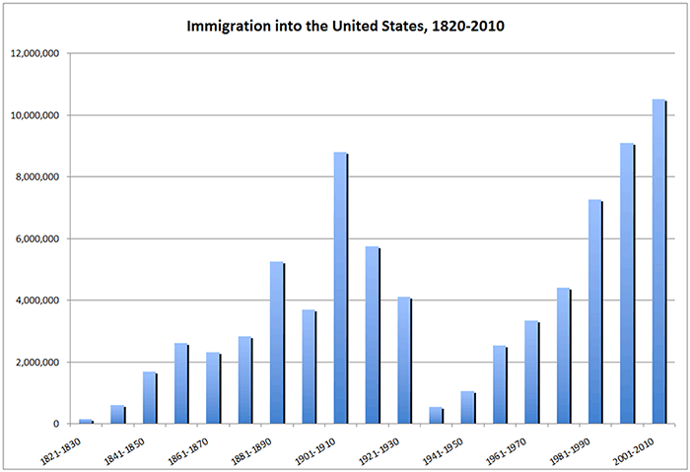
Immigration By the Numbers

Slide 11
questions
1) Which group of immigrants do you think thrived more in American society- old or new immigrants? Explain.
2) Think back to the Do Now question from today. Based on what we have learned about immigration (specifically the experiences of immigrants) during the late 19th to early 20th century, has your answer changed at all? How?

