Slide 1
The Atom Bomb
Mr. Accetta
Social Studies 8

Slide 2
Background
By 1945, Japan showed no signs of surrendering the war.
U.S. scientists had developed a weapon capable of causing levels of destruction never seen before.

Slide 3
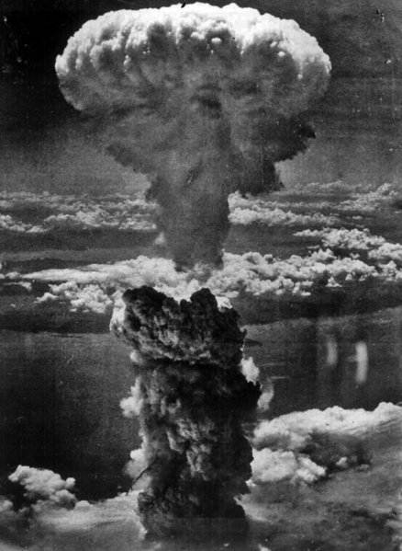
Decision
President Harry S. Truman made the decision to use the atom bomb in order to avoid an invasion of Japan, risking thousands of American lives.

Slide 4
Impact
August 6, 1945: 1st atomic bomb dropped on Hiroshima- 90,000-146,000 killed
August 9, 1945: 2nd atomic bomb dropped on Nagasaki- 39,000-80,000 killed
August 15, 1945: Japan officially surrenders

Slide 5
Review Questions
1) What was the purpose of the atomic bomb?
2) How would you describe the impact that the atomic bomb had, in your own words?
3) Name one reason for and one reason against using the atomic bomb.
4) If you were President Truman, would you have decided to use the bomb? Why or why not?

Slide 6
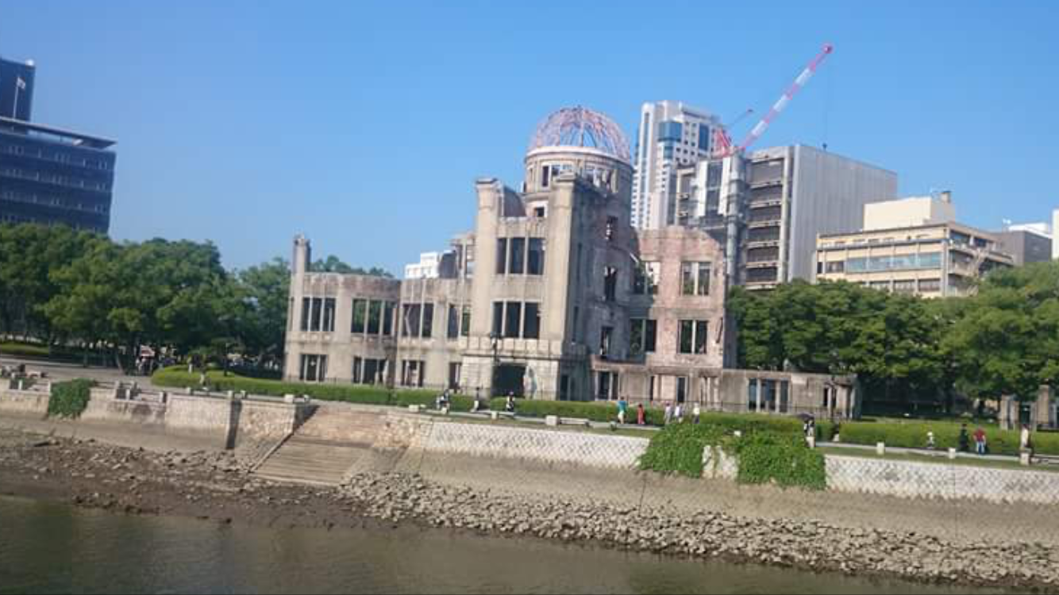
Hiroshima: Then vs Now

